Slide 1

Financial Fraud Risk Management
by
Avinash Pentyala

Slide 2
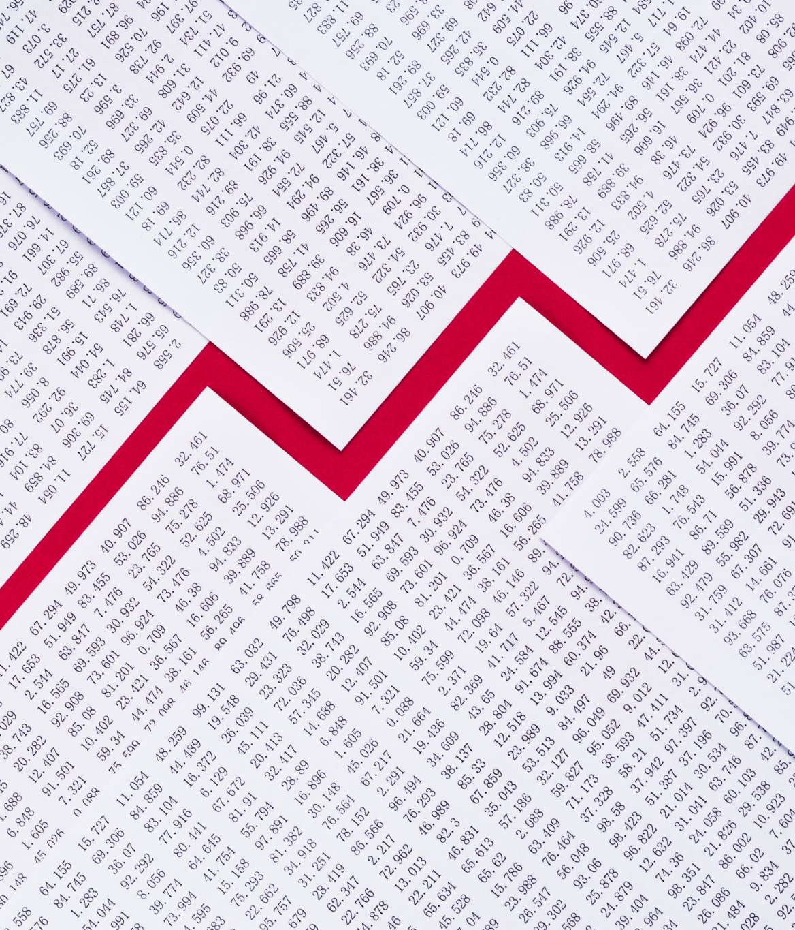
Objective
The main objective of this paper is to address the overview of risk management and focuses on the programs that are conducted by an organization that addresses fraud and misconduct.
A fraud risk assessment is aimed at proactively addressing a business’s vulnerabilities to internal and external fraud.
Though types of fraud vary by business line, internal frauds include embezzlement and misappropriation of assets, while external frauds include hacking and theft of proprietary information

Slide 3

Introduction
The American economy is built on private businesses.
Extortion is a significant contributing factor to independent company failure, and recent research suggests that organizations lose roughly 5% of their annual profits to misrepresentation
the unique challenges and opportunities that private ventures have when it comes to misrepresentation risk on the board.
It is observed how these conflicts develop and can empathize with business owners who unintentionally hire a cheater's survivor.

Slide 4

Fraud Prevention:
Developing ethical culture
Internal control systems
Fraud Detection:
Detection Methods
Tools and Techniques
Responding to fraud:
Roles and Responsibilities
Organizations dealing with fraud

Slide 5
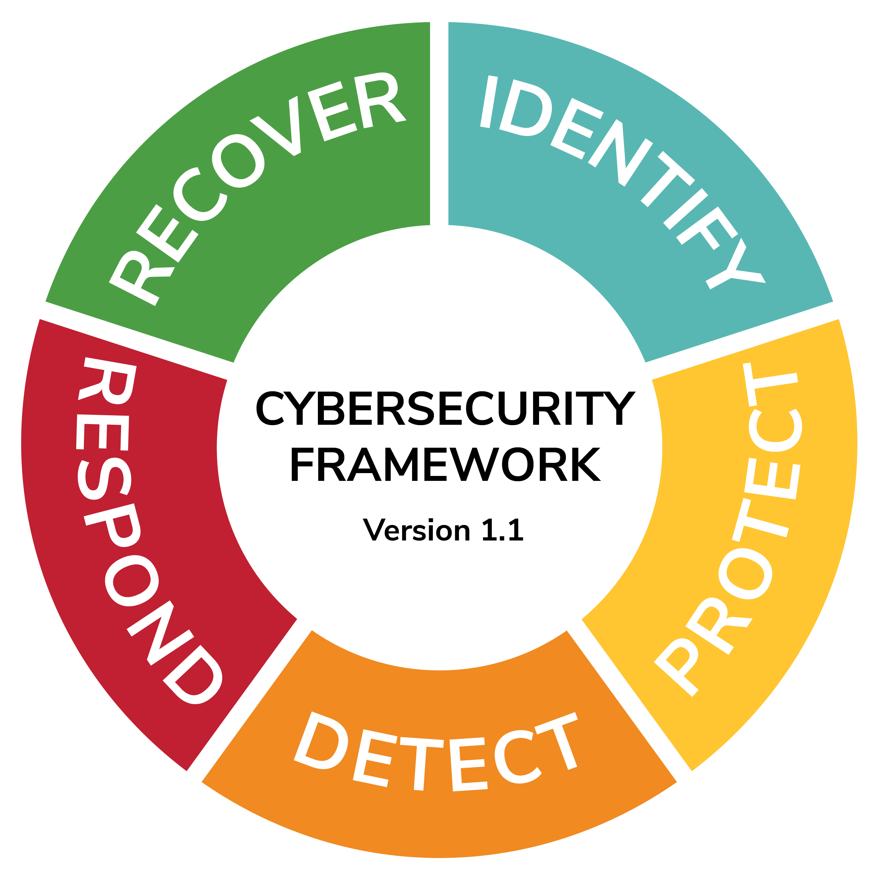
Cyber Risk Management
Ongoing Process- Identify, analyze, evaluate, address threats
Job of a security team
Everyone plays equal roles
Often business unit leaders view risk management from their business function
The holistic perspective necessary to address risk in a comprehensive and consistent manner.

Slide 6

Risk Assessment
Two financial sectors chosen as examples
analyzing the potential hazards
impacts that could negatively affect
PayPal
Zelle

Slide 7
How PayPal users gets scammed
Advance Payment fraud
PayPal account problems
Overpayment refund scams
Fraud involving delivery and payment cancellation
Charitable-contribution and investment scams
How to avoid?
Messages: grammatical mistakes, attempts to incite a sense of urgency or danger
Check any potential issues through your personal account on the website
Not give out personal information to the other party

Slide 8
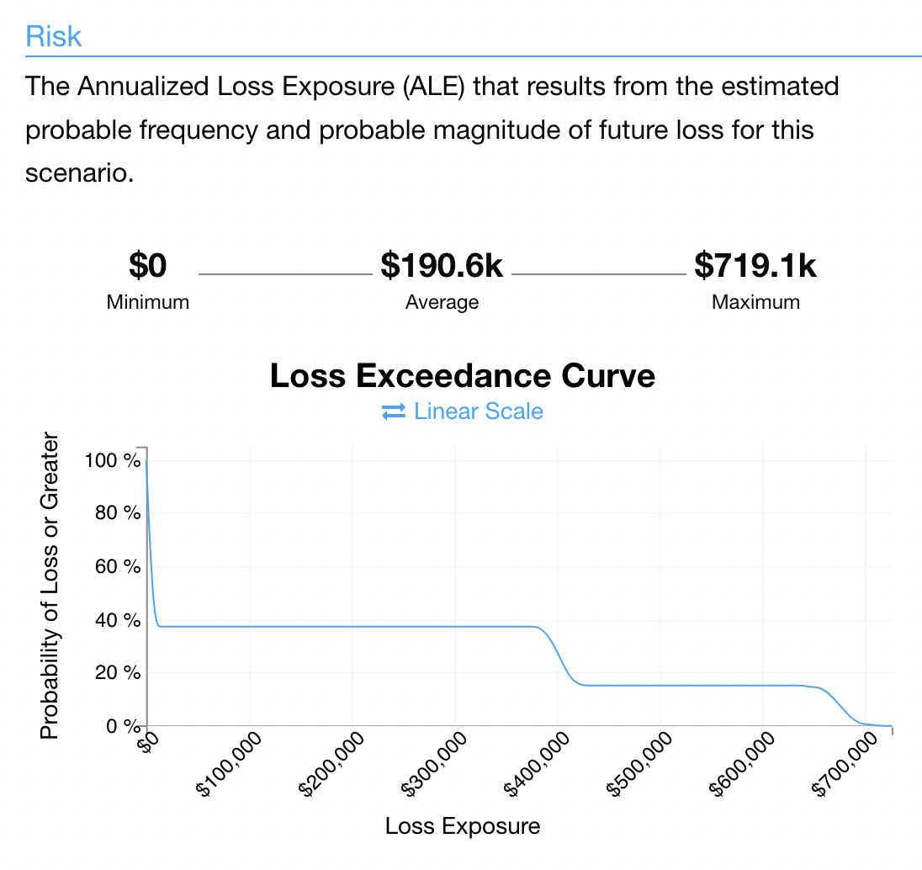
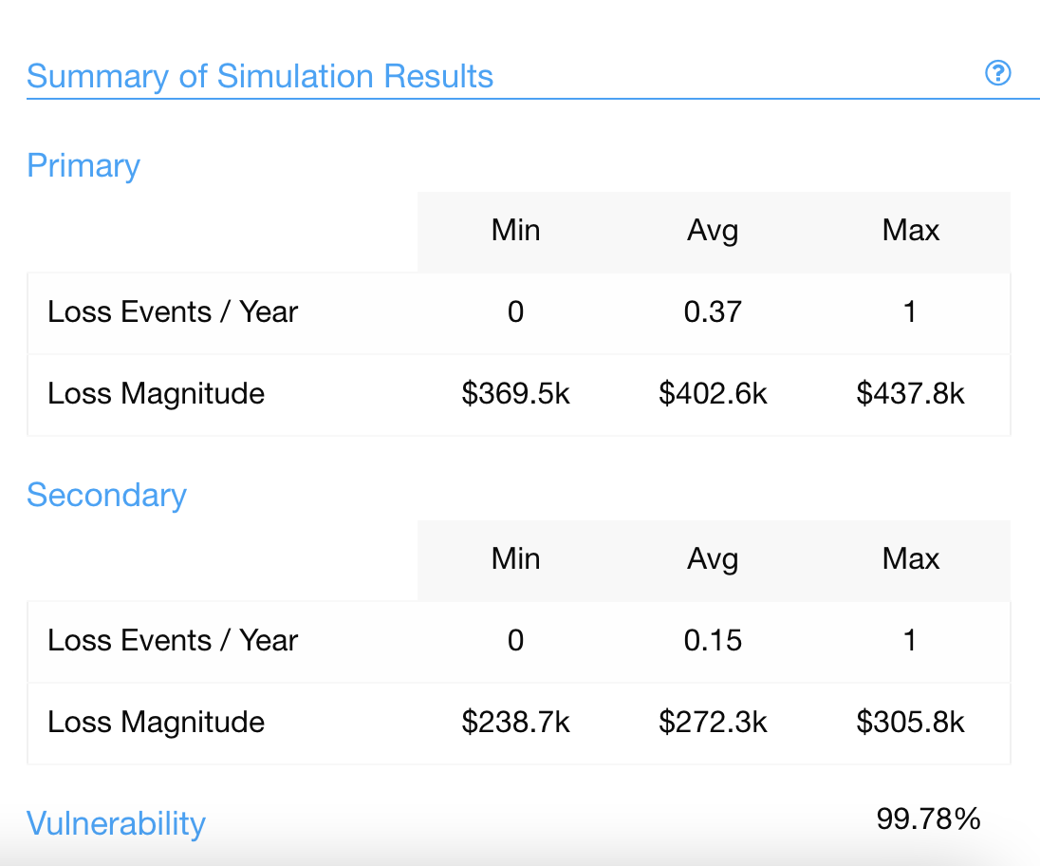
Risk Analysis (scenario-1)

Slide 9
How are risks avoided ( After safety measures)
Even clients with legitimate credentials are capable of friendly fraud if they are impatient or ignorant. Insist on delivery signature confirmation when delivering expensive things.
If you enroll in the Seller Protection Program offered by PayPal, some types of fraud will be paid for by PayPal.
Customers who create fraud or dispute claims should be blocked. If no action is taken against a vendor, fraudsters frequently target them repeatedly.
Check the actual email address rather than the sender name when you receive an email from PayPal to ensure that it is authentic. When in doubt, sign into your account in a new tab to double-check the details.
Shipments must only be made to the address specified in the transaction details.

Slide 10
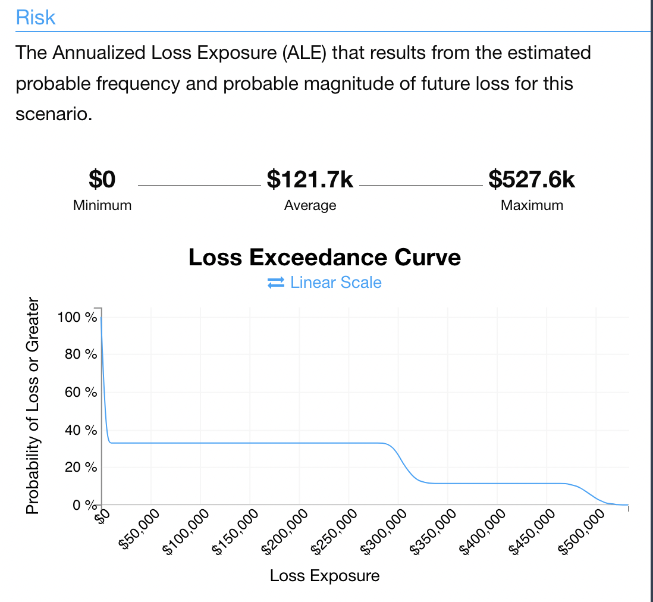
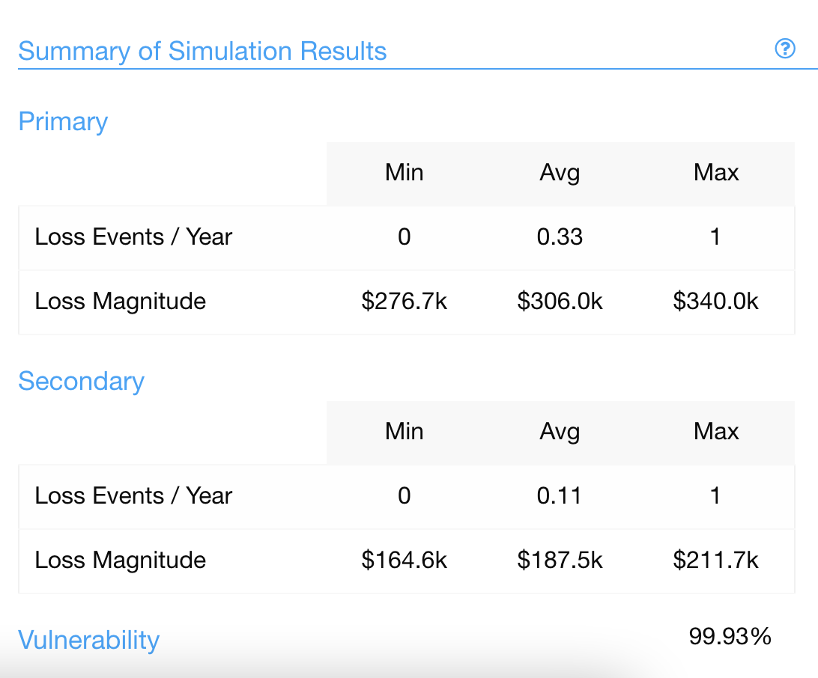
Risk Analysis( scenario-1-2)

Slide 11

Zelle Fraud is Rising
Zelle, the popular payment app, is under fire for how it handles
Zelle showed that fraud and theft are not only rampant but getting worse
Banks are not repaying 90% of cases in which customers were tricked into making payments on Zelle.
PNC Bank indicated that its customers reported 10,683 cases of unauthorized payments

Slide 12
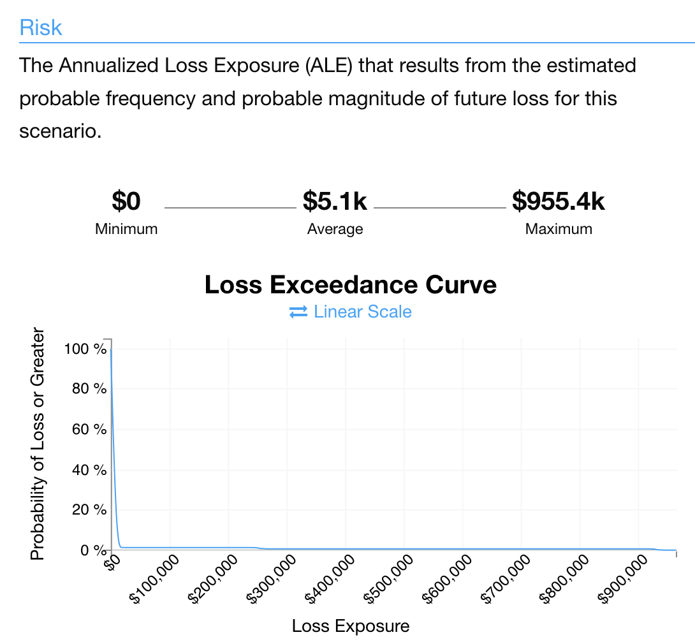
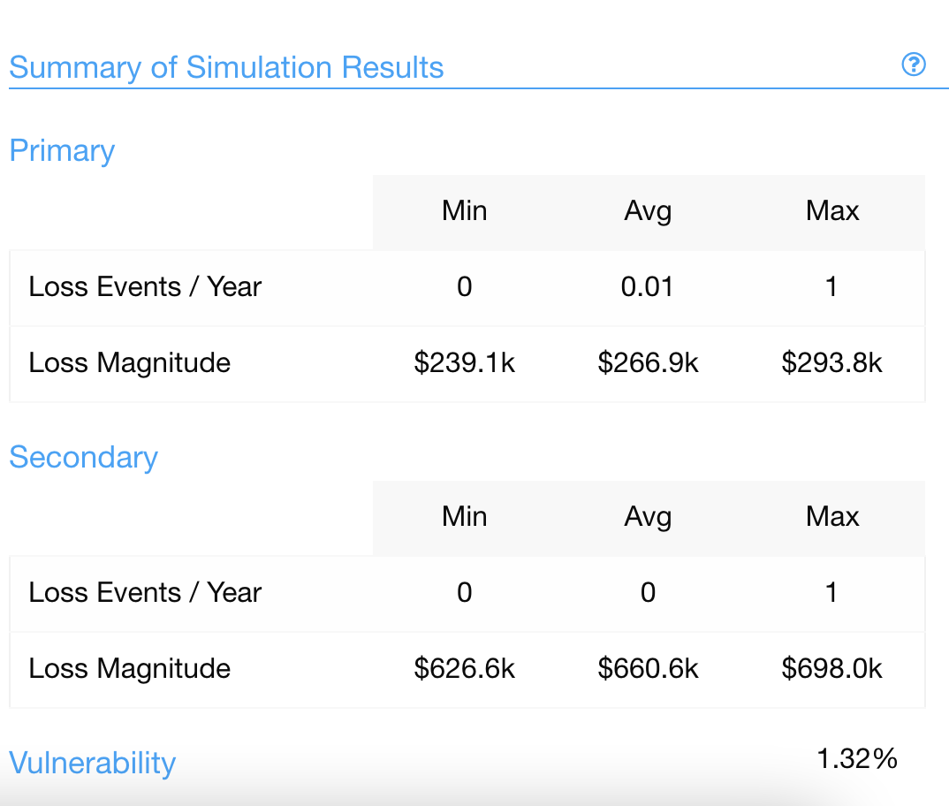
Risk Analysis (scenario-2)

Slide 13
Conclusion
Technologies for electronic payments present both potential and difficulties.
The biggest obstacle to using online payments is fraud prevention and security.
Two financial sectors are been analyzed for risk evaluation i.e., PayPal and Zelle
PayPal prioritizes investing in the fight against fraud.
With the safety measures, the primary losses and secondary losses are been decreasd by approximately 30%
For more than ten years, the business has used real-time decision-making in conjunction with effective fraud prevention methods.
However, scammers are continually altering their strategies and finding new methods to abuse the system.
Its always good to be aware of the risks by the frauds and take preventive measures.

